Slide 1

Chandigarh University
Department of Mathematics
B.Tech. CSE (Core/DS/IT/CC)
Semester-3
Subject Code:25MTT-202
Discrete Mathematics
Chapter:1.3.1
Dr. SARTAJ
DISCOVER . LEARN . EMPOWER

Slide 2

CO mappings

Slide 3

CO-PO mappings
Note: Degree of relevance/correlation: 1-Low, 2-Medium, 3-High, Blank or ‘- ‘- Nil

Slide 4
Topics Covered
Introduction to Proof
Direct Proof
Proof by Contradiction
Conclusions
Video links
References

Slide 5
Introduction to Proof
A proof is a logical argument that establishes the truth of a mathematical statement.
It consists of a sequence of statements, each justified by axioms, definitions, or previously proven theorems.
Why proofs matter:
Ensures mathematical statements are rigorously true.
Used in fields like cryptography, artificial intelligence, and software verification.
Helps develop logical reasoning skills.

Slide 6
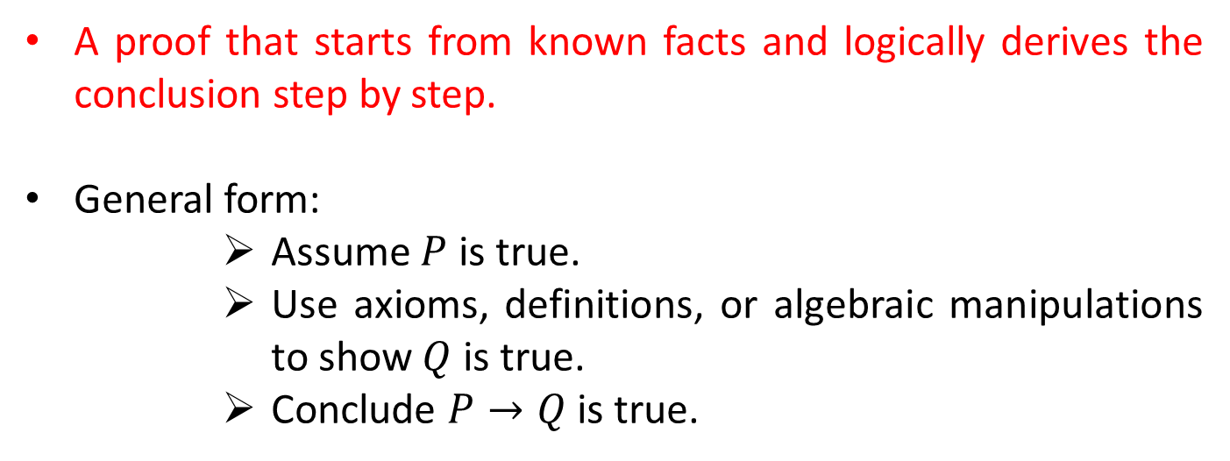
Direct Proof
A proof that starts from known facts and logically derives the conclusion step by step.
General form:
Assume $P$ is true.
Use axioms, definitions, or algebraic manipulations to show $Q$ is true.
Conclude $P→Q$ is true.

Slide 7
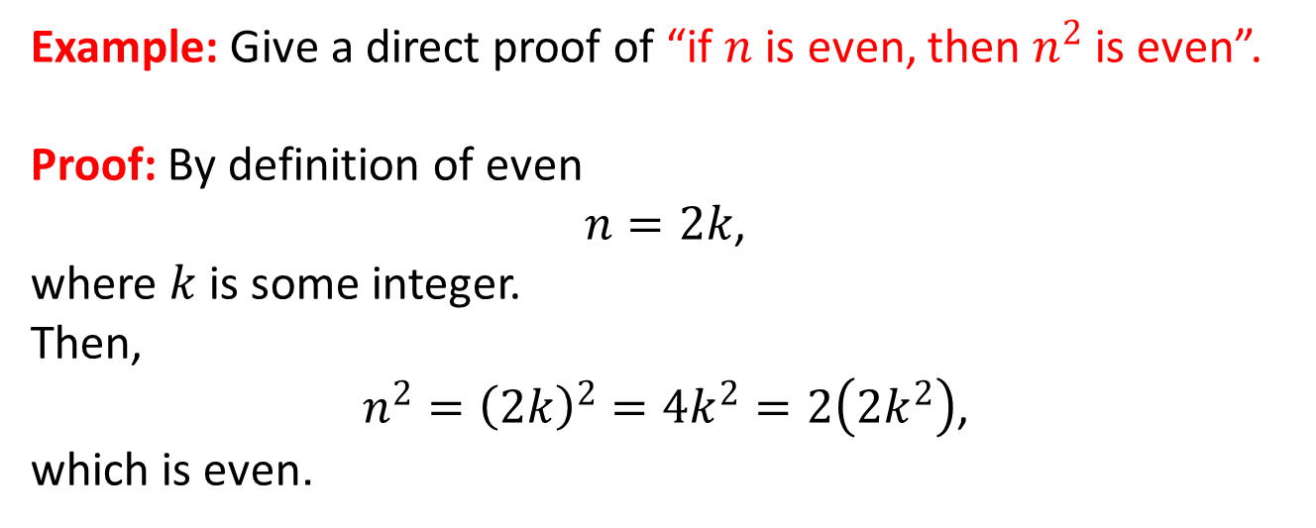
Direct Proof
Example: Give a direct proof of “if $n$ is even, then $n^{2}$ is even”.
Proof: By definition of even
$n=2k$,
where $k$ is some integer.
Then,
$n^{2}={\left(2k\right)}^{2}=4k^{2}=2\left(2k^{2}\right)$,
which is even.

Slide 8
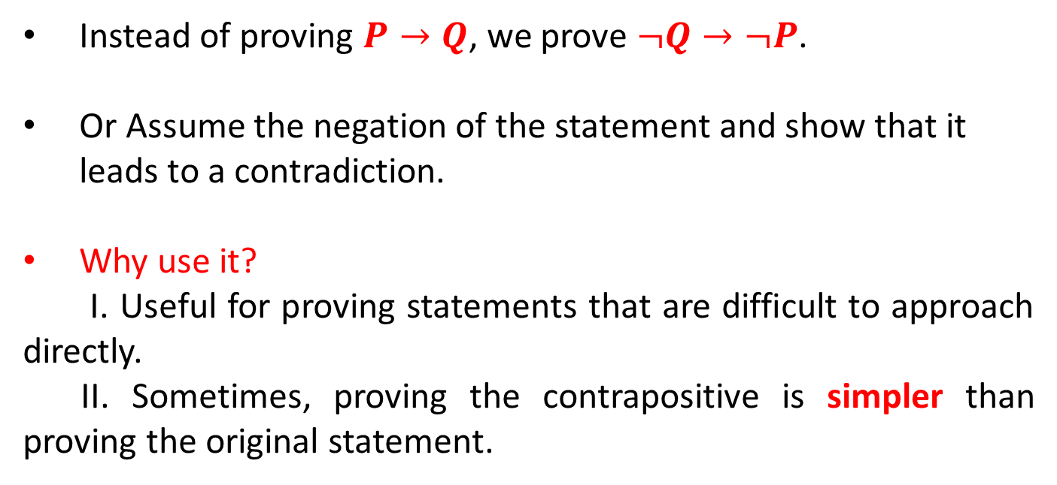
Proof by Contraposition (or Contradiction)
Instead of proving $P→Q$, we prove $¬Q→¬P$.
Or Assume the negation of the statement and show that it leads to a contradiction.
Why use it?
I. Useful for proving statements that are difficult to approach directly.
II. Sometimes, proving the contrapositive is simpler than proving the original statement.

Slide 9
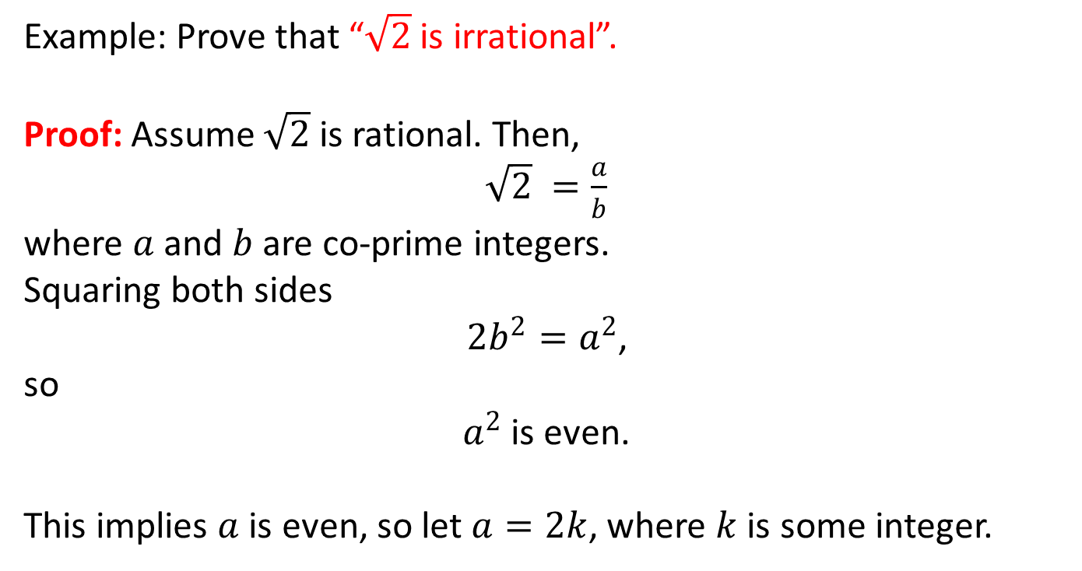
Proof by Contraposition (or Contradiction)
Example: Prove that “$\sqrt{2}$ is irrational”.
Proof: Assume $\sqrt{2}$​ is rational. Then,
$\sqrt{2} =\frac{a}{b}$​
where $a$ and $b$ are co-prime integers.
Squaring both sides
$2b^{2}=a^{2}$,
so
$a^{2}$ is even.
This implies $a$ is even, so let $a=2k$, where $k$ is some integer.

Slide 10
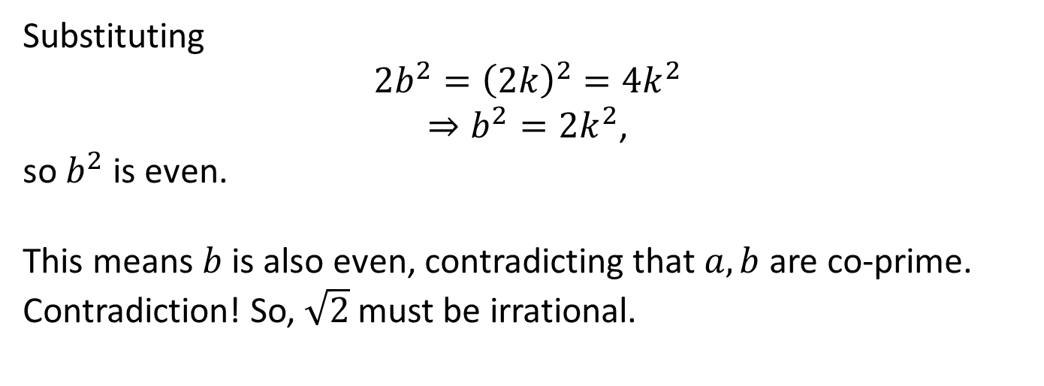
Proof by Contraposition (or Contradiction)
Substituting
$$2b^{2}={\left(2k\right)}^{2}=4k^{2}$$
$⇒b^{2}=2k^{2}$,
so $b^{2}$ is even.
This means $b$ is also even, contradicting that $a,b$ are co-prime.
Contradiction! So, $\sqrt{2}$​ must be irrational.

Slide 11
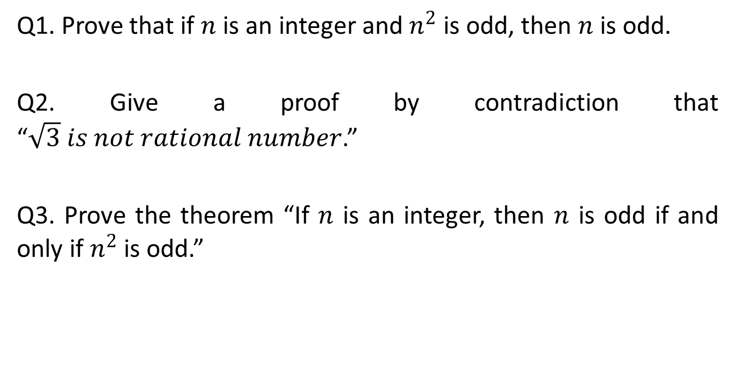
Learning Activity
Q1. Prove that if $n$ is an integer and $n^{2}$ is odd, then $n$ is odd.
Q2. Give a proof by contradiction that “$\sqrt{3} is not rational number$.”
Q3. Prove the theorem “If $n$ is an integer, then $n$ is odd if and only if $n^{2}$ is odd.”

Slide 12
Conclusion
Discuss Direct and Contradiction techniques of proofs.
Related applications and problems are discussed.

Slide 13
Video Links
https://www.youtube.com/watch?v=sPQ3ptUMltA&utm_source=chatgpt.com
https://youtu.be/YYQfYBNlfZg?si=bzEHNN2yciHgzZjb

Slide 14
References
Sr. No. | Author | Name of the Book | Publisher | Year of Publication
1 | Kenneth H. Rosen | Discrete Mathematics and Its Applications | McGraw-Hill | 2019
2 | C. L. Liu | Elements of Discrete Mathematics | McGraw-Hill | 1996
3 | J. P. Tremblay, R. Manohar | Discrete Mathematical Structures with Applications to Computer Science | Tata McGraw Hill | 2001
4 | Kolman, Busby, Ross | Discrete Mathematical Structures | PHI | 2001
5 | Narsingh Deo | Graph Theory with Applications to Engineering and | PHI | 2017

Slide 15
Thanks!!!

